Slide 1
Bisection Method
by Dr. Md. Rajibul Islam CSE, UAP
*
‹#›

Slide 2
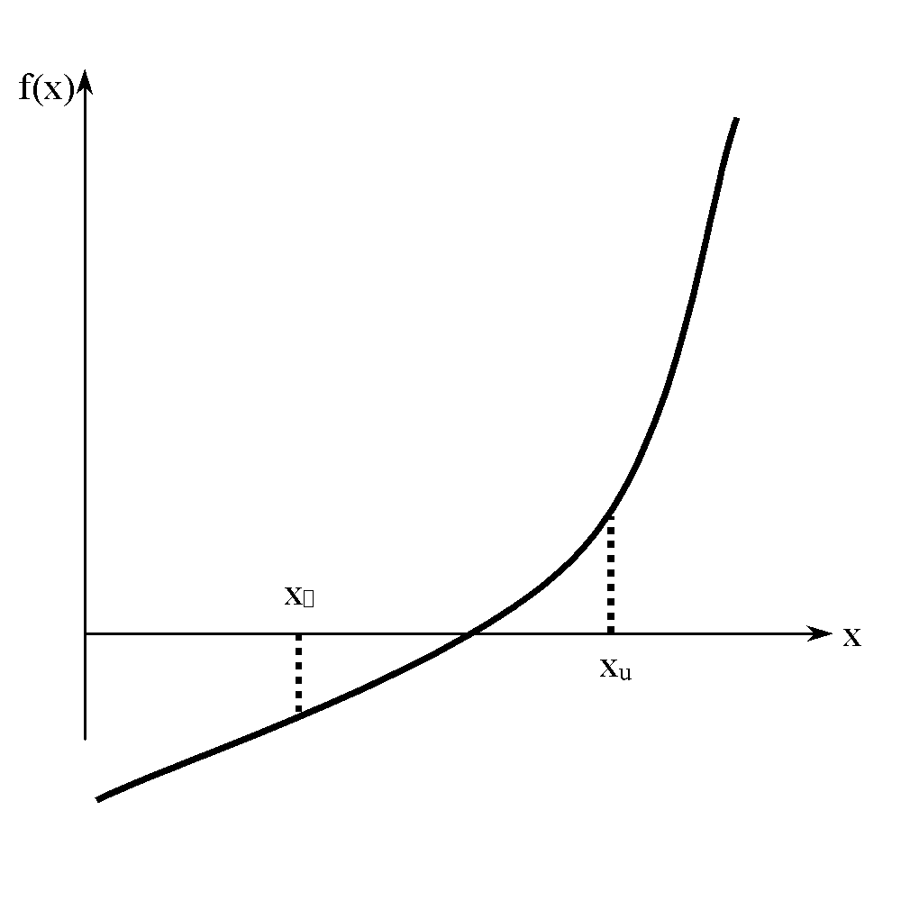
Basis of Bisection Method/ binary search method
Theorem
An equation f(x)=0, where f(x) is a real continuous function, has at least one root between x_{l} and x_{u} if f(x_{l}) f(x_{u}) < 0.
Figure 1 At least one root exists between the two points if the function is real, continuous, and changes sign.
‹#›

Slide 3
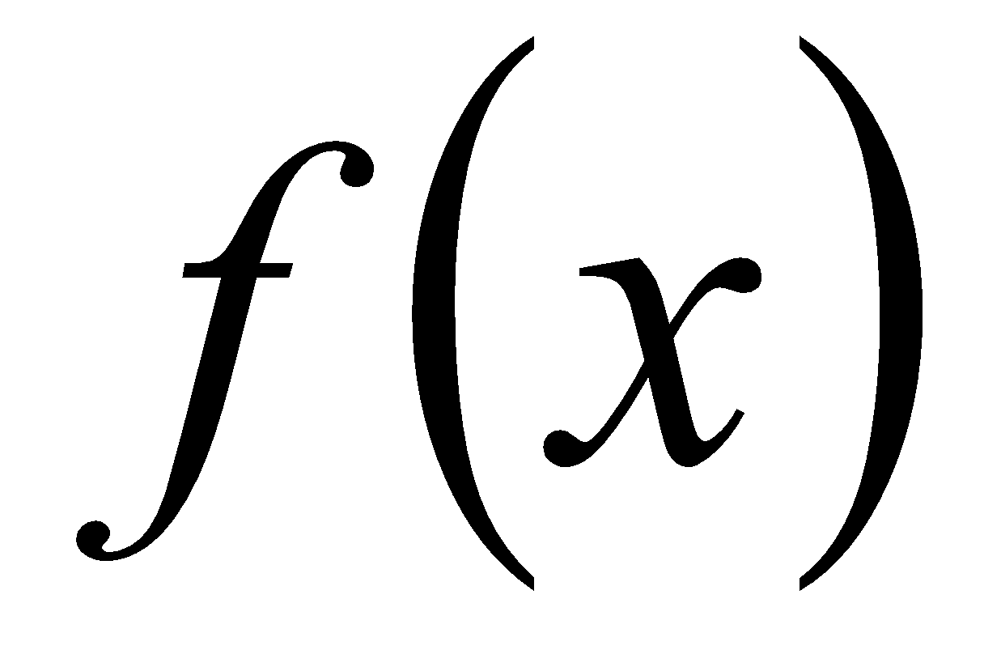
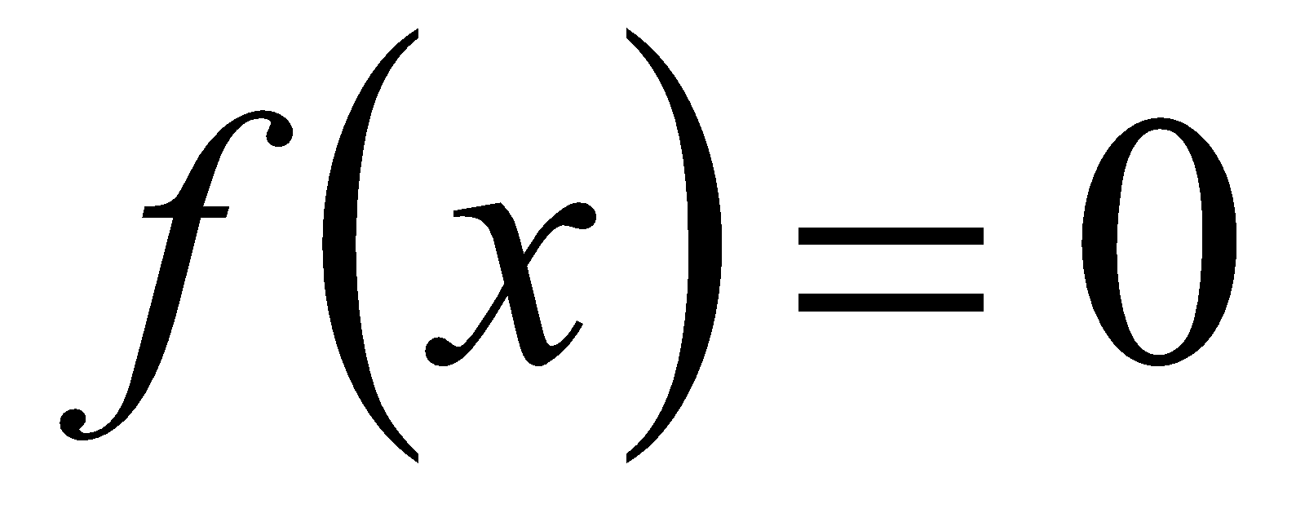
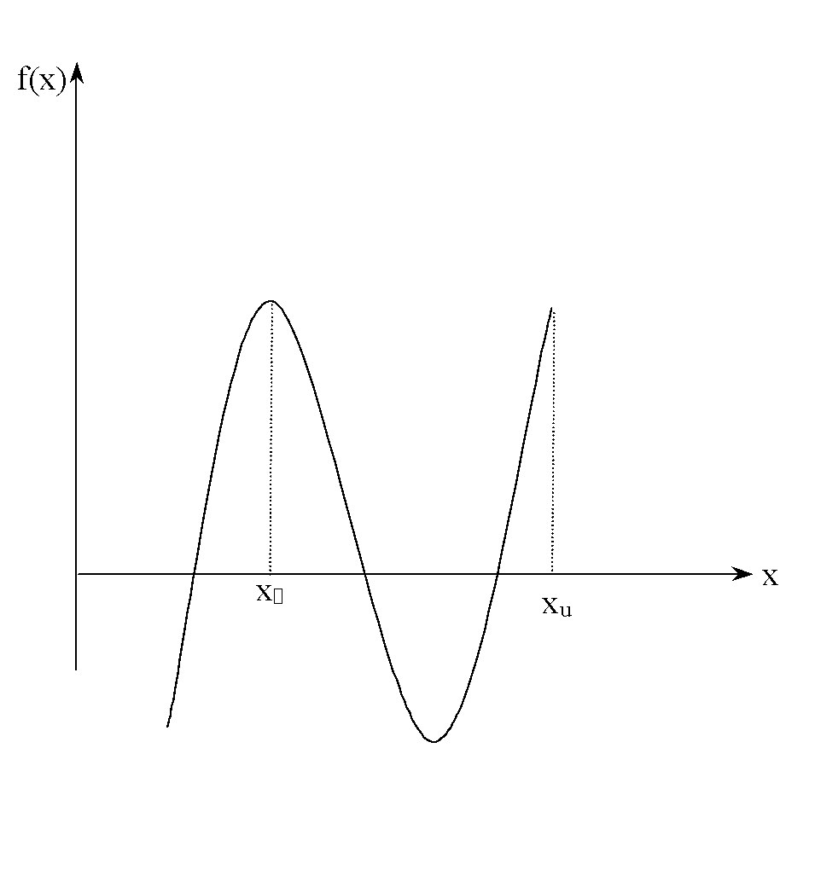
Basis of Bisection Method
Figure 2 If function does not change sign between two points, roots of the equation may still exist between the two points.
‹#›

Slide 4
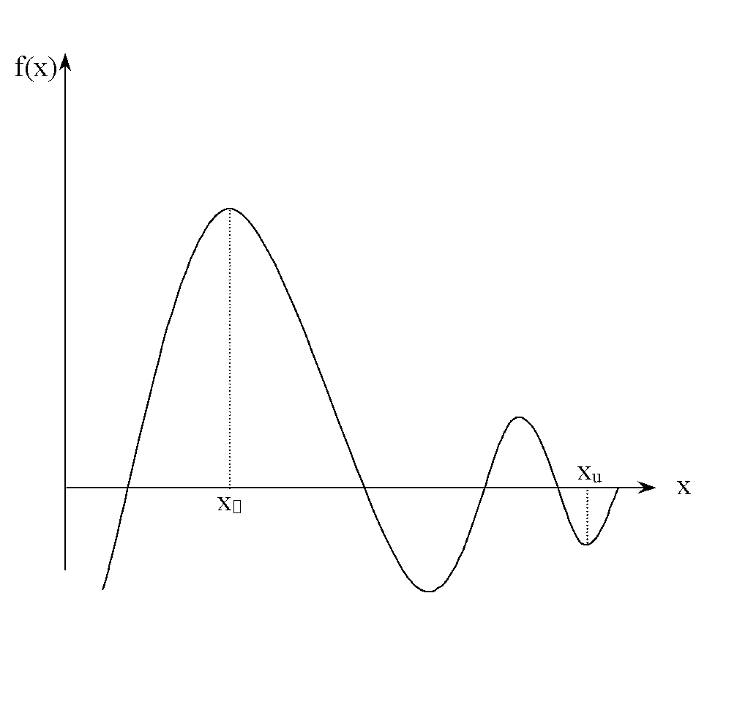
Basis of Bisection Method
Figure 4 If the function changes sign between two points, more than one root for the equation may exist between the two points.
‹#›

Slide 5
Algorithm for Bisection Method
‹#›

Slide 6
Step 1
Choose x_{l} and x_{u} as two guesses for the root such that f(x_{l}) f(x_{u}) < 0, or in other words, f(x) changes sign between x_{l} and x_{u}. This was demonstrated in Figure 1.
Figure 1
‹#›

Slide 7
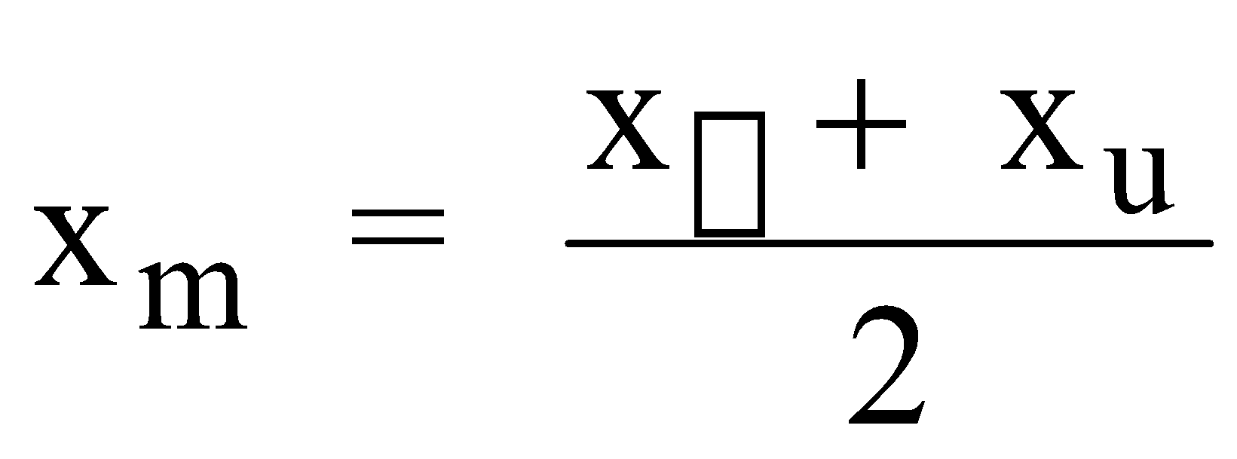
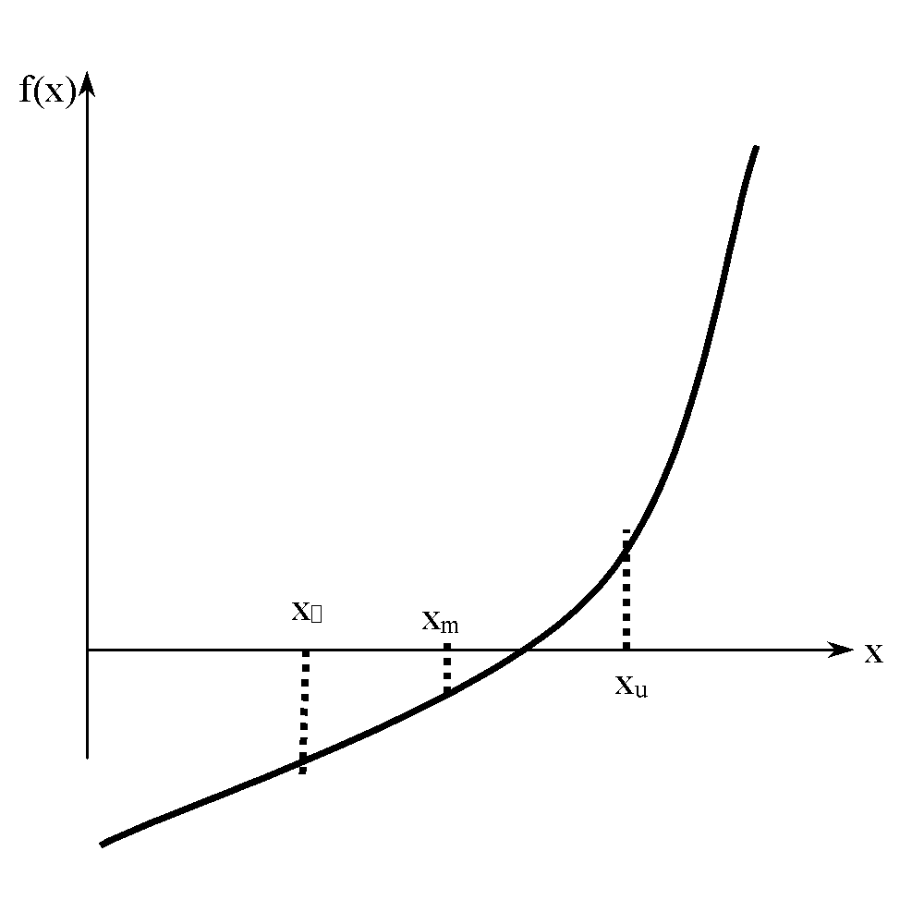
Step 2
Estimate the root, x_{m} of the equation f (x) = 0 as the mid point between x_{l} and x_{u} as
Figure 5 Estimate of x_{m}
‹#›

Slide 8
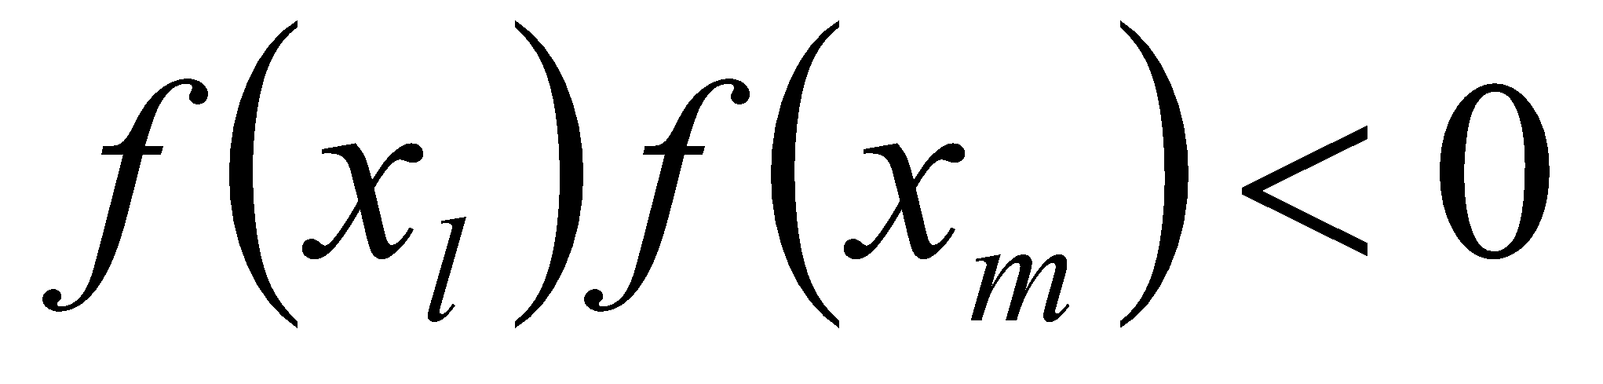
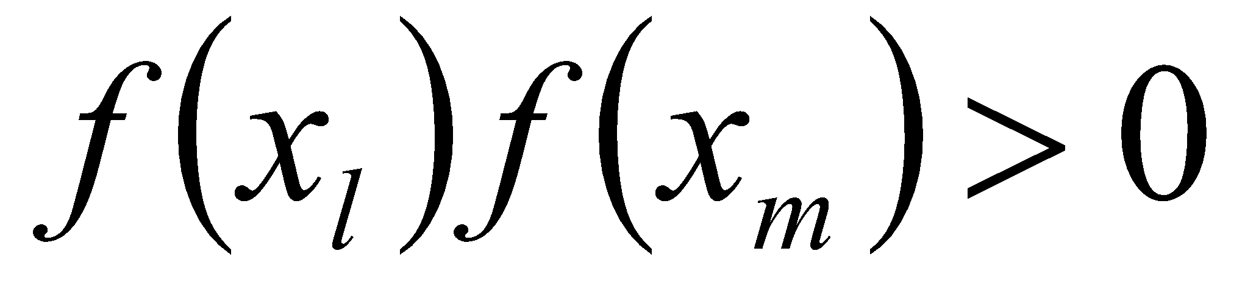
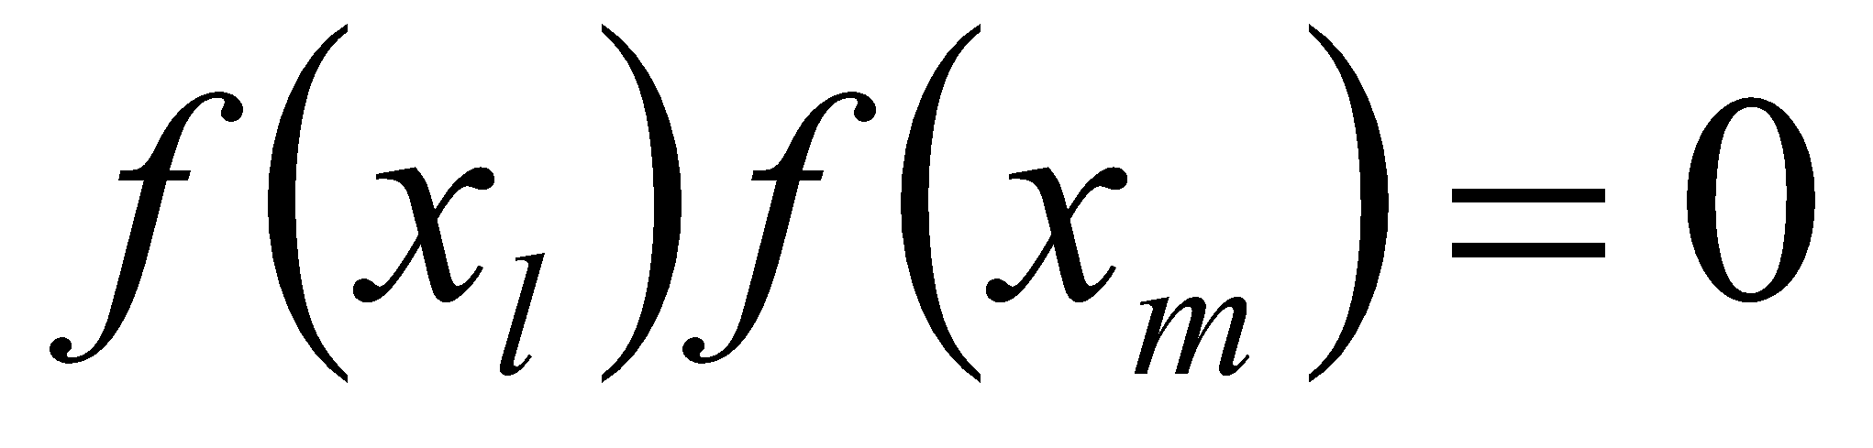
Step 3
Now check the following
If , then the root lies between x_{l} and x_{m}; then x_{l} = x_{l} ; x_{u} = x_{m}.
If , then the root lies between x_{m} and x_{u}; then x_{l} = x_{m}; x_{u} = x_{u}.
If ; then the root is x_{m.} Stop the algorithm if this is true.
‹#›

Slide 9
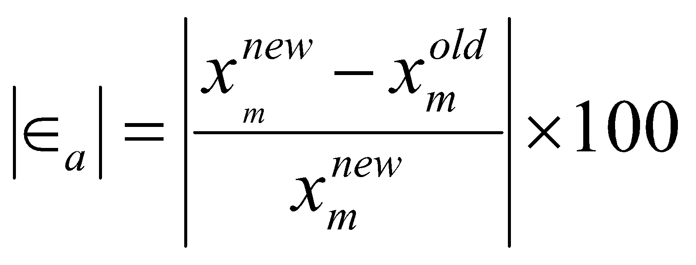
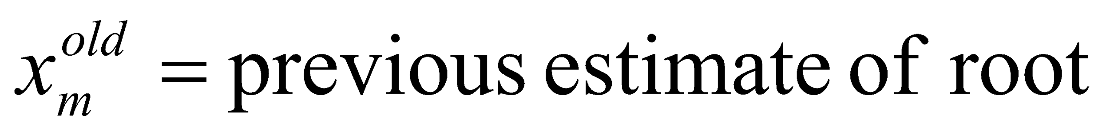
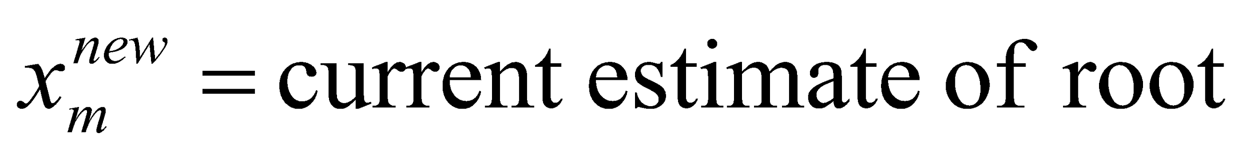
Step 4
Find the new estimate of the root
Find the absolute relative approximate error
where
‹#›

Slide 10
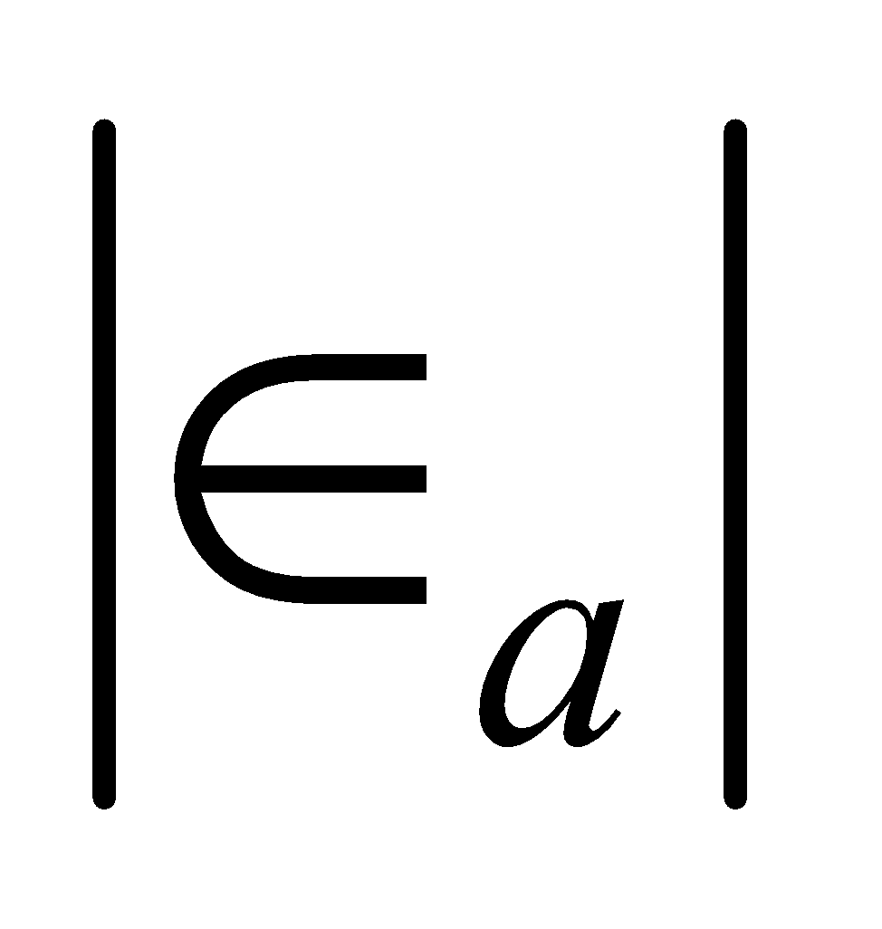
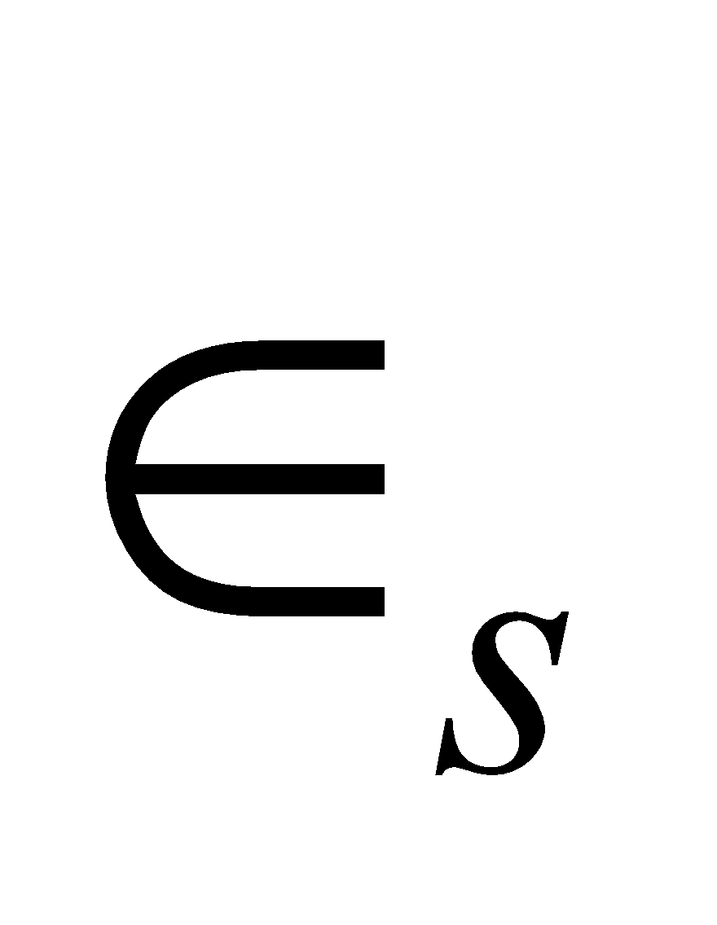
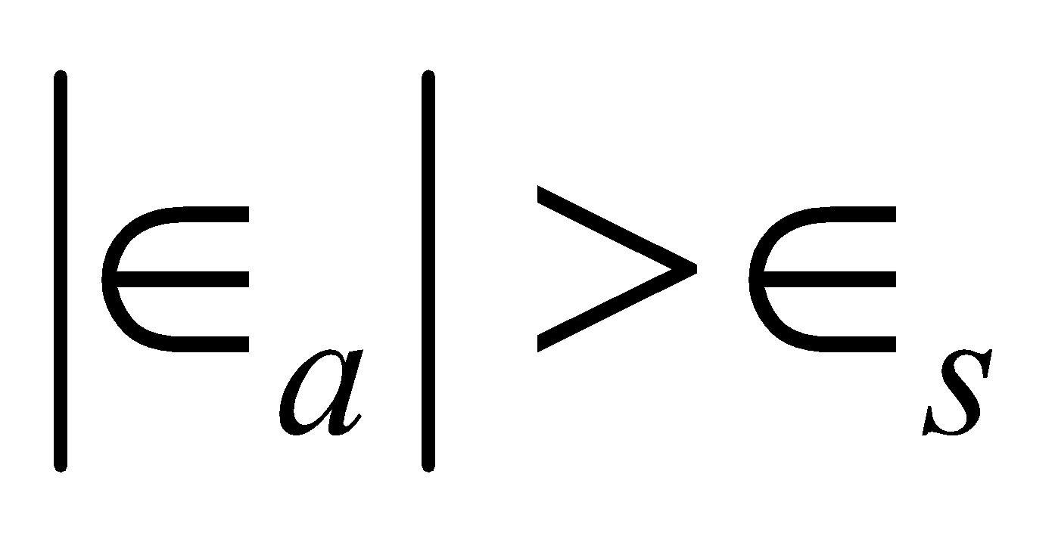
Step 5
Compare the absolute relative approximate error with the pre-specified error tolerance .
Go to Step 2 using new upper and lower guesses.
Yes
Is ?
No
Stop the algorithm
Note: one should also check whether the number of iterations is more than the maximum number of iterations allowed. If so, one needs to terminate the algorithm and notify the user about it.
‹#›

Slide 11
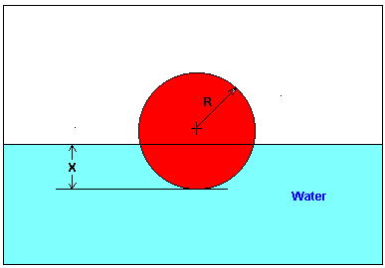
Example 1
You are working for ‘DOWN THE TOILET COMPANY’ that makes floats for ABC commodes. The floating ball has a specific gravity of 0.6 and has a radius of 5.5 cm. You are asked to find the depth to which the ball is submerged when floating in water.
Figure 6 Diagram of the floating ball
‹#›

Slide 12
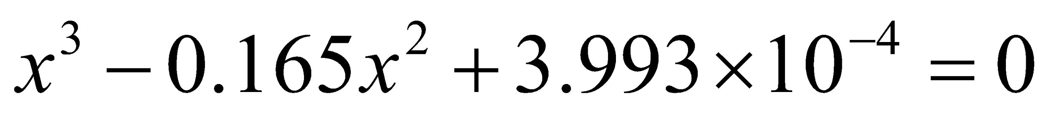
Example 1 Cont.
The equation that gives the depth x to which the ball is submerged under water is given by
a) Use the bisection method of finding roots of equations to find the depth x to which the ball is submerged under water. Conduct three iterations to estimate the root of the above equation.
b) Find the absolute relative approximate error at the end of each iteration, and the number of significant digits at least correct at the end of each iteration.
‹#›

Slide 13
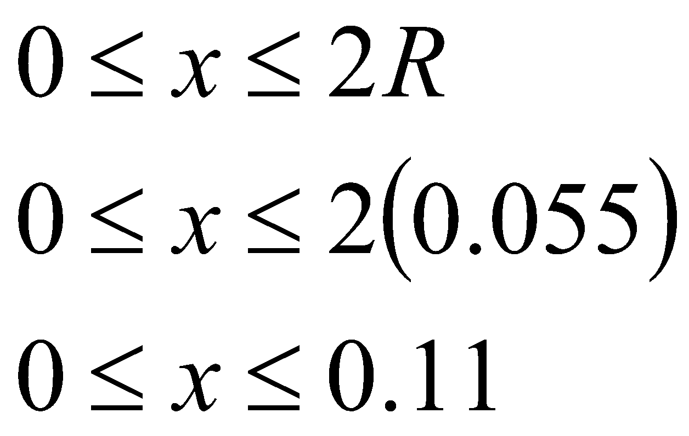
Example 1 Cont.
From the physics of the problem, the ball would be submerged between x = 0 and x = 2R,
where R = radius of the ball,
that is
Figure 6 Diagram of the floating ball
‹#›

Slide 14
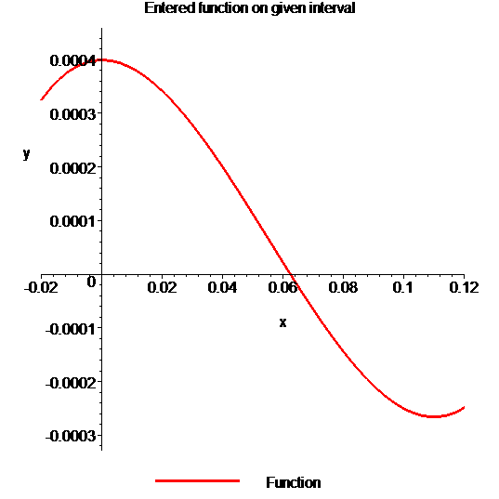

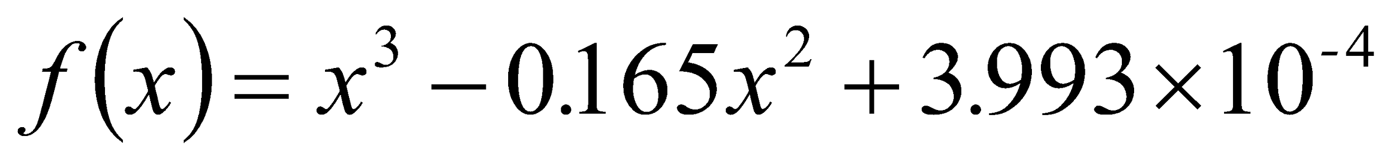
Example 1 Cont.
Solution
To aid in the understanding of how this method works to find the root of an equation, the graph of f(x) is shown to the right,
where
Figure 7 Graph of the function f(x)
‹#›

Slide 15
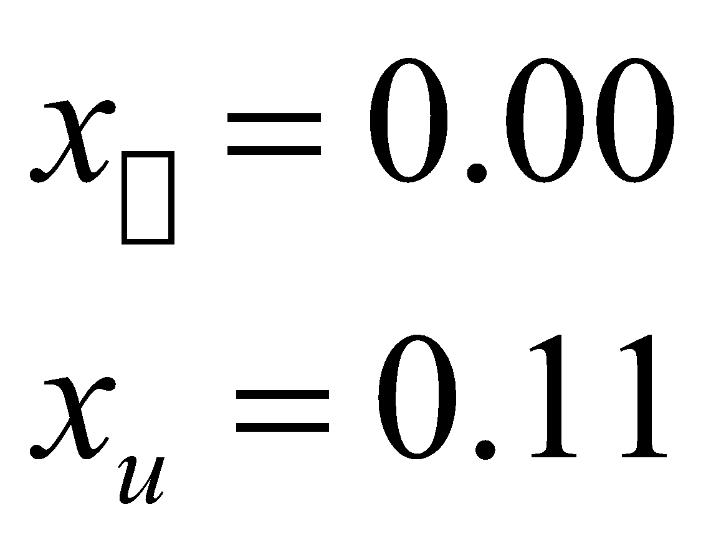
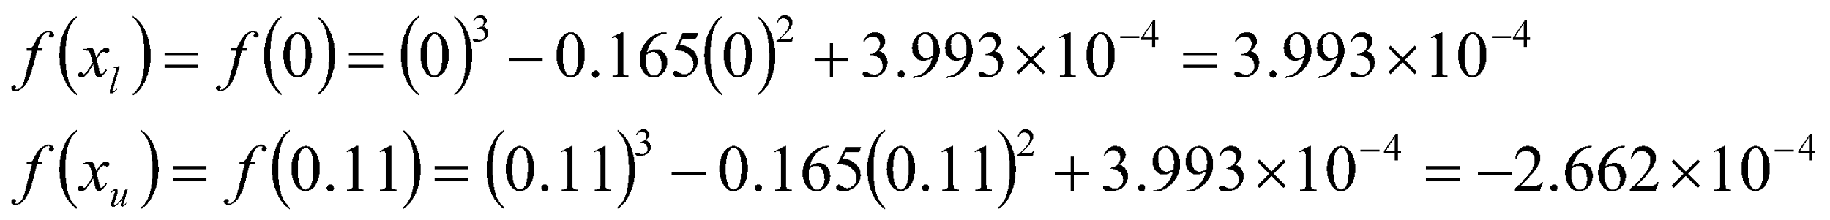
Example 1 Cont.
Let us assume
Check if the function changes sign between x_{l} and x_{u .}
Hence
So there is at least on root between x_{l} and x_{u,} that is between 0 and 0.11
‹#›

Slide 16
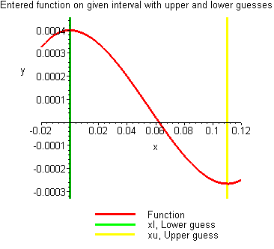
Example 1 Cont.
Figure 8 Graph demonstrating sign change between initial limits
‹#›

Slide 17
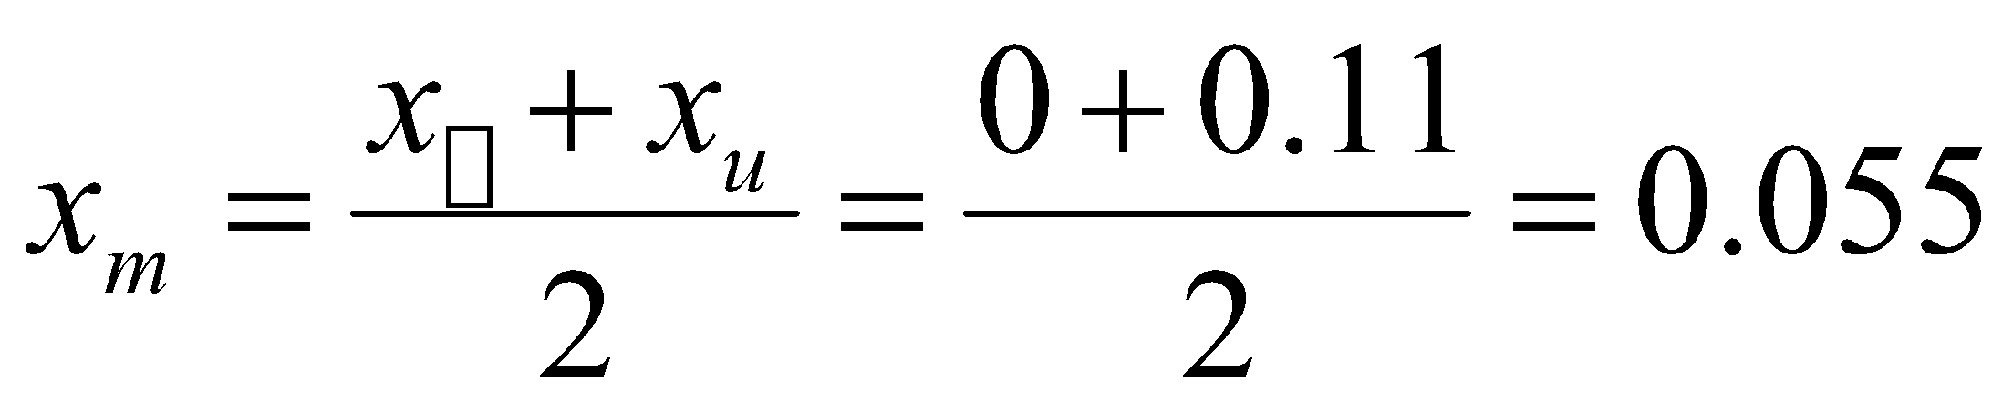
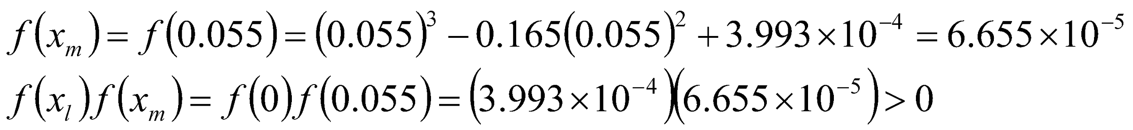
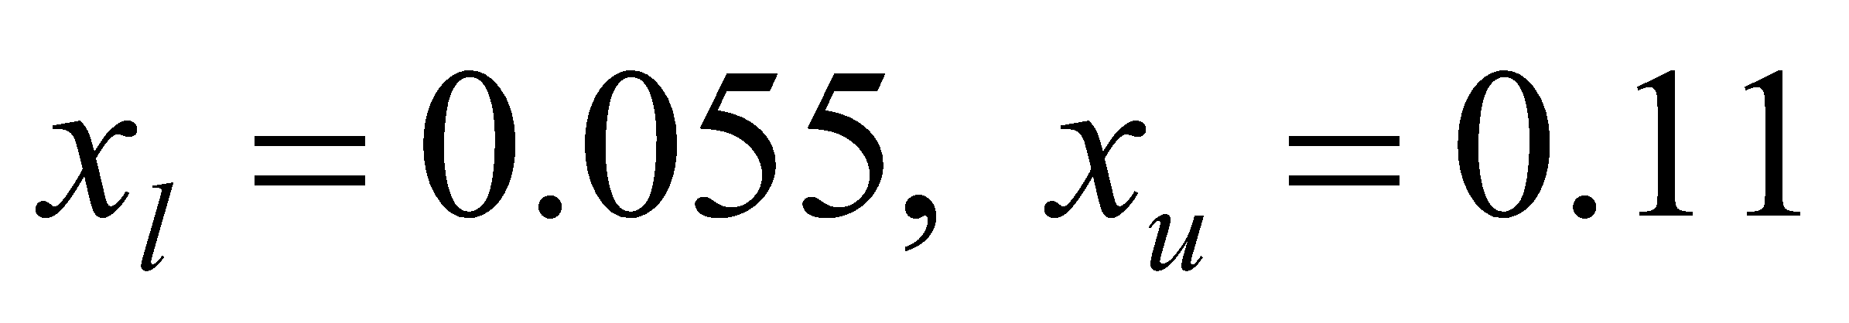
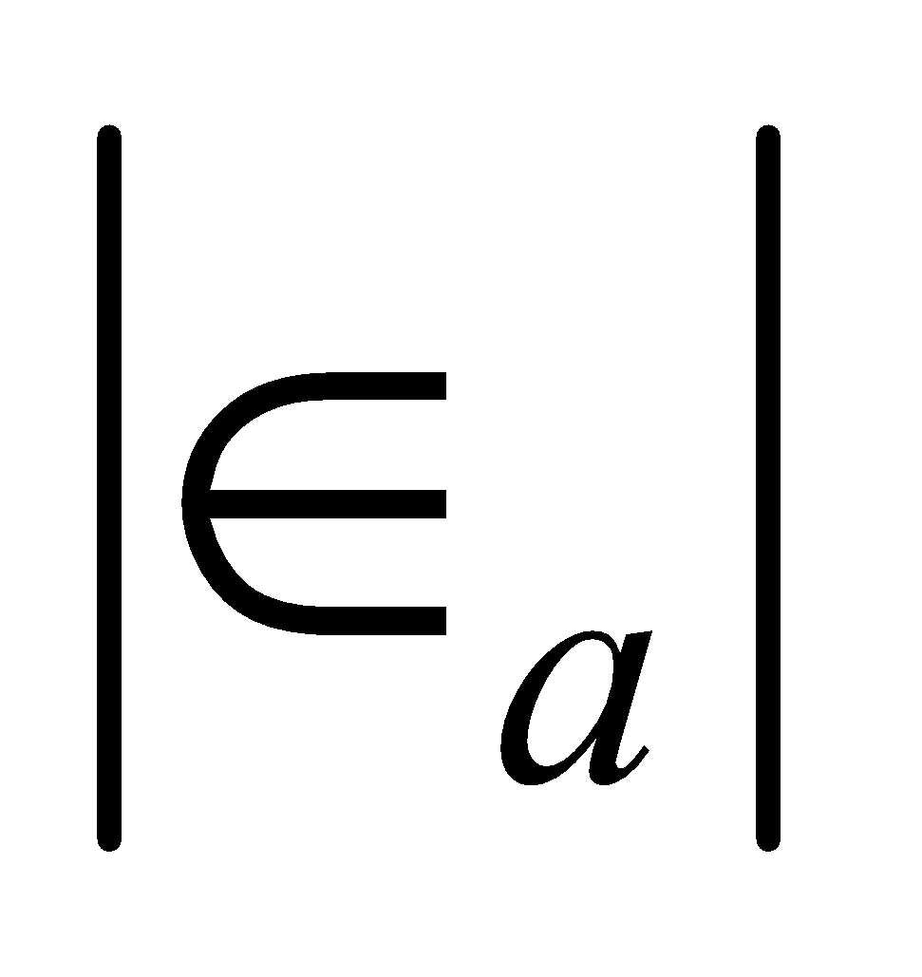
Example 1 Cont.
Iteration 1
The estimate of the root is
According to step 3, slide no. 8
Hence the root is bracketed between x_{m} and x_{u}, that is, between 0.055 and 0.11. So, the lower and upper limits of the new bracket are
At this point, the absolute relative approximate error cannot be calculated as we do not have a previous approximation.
‹#›

Slide 18
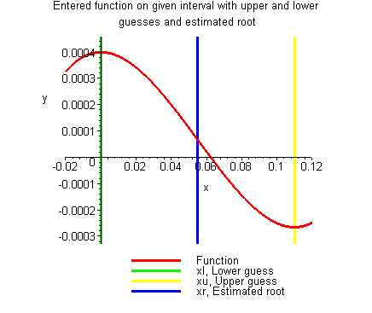
Example 1 Cont.
Figure 9 Estimate of the root for Iteration 1
‹#›

Slide 19
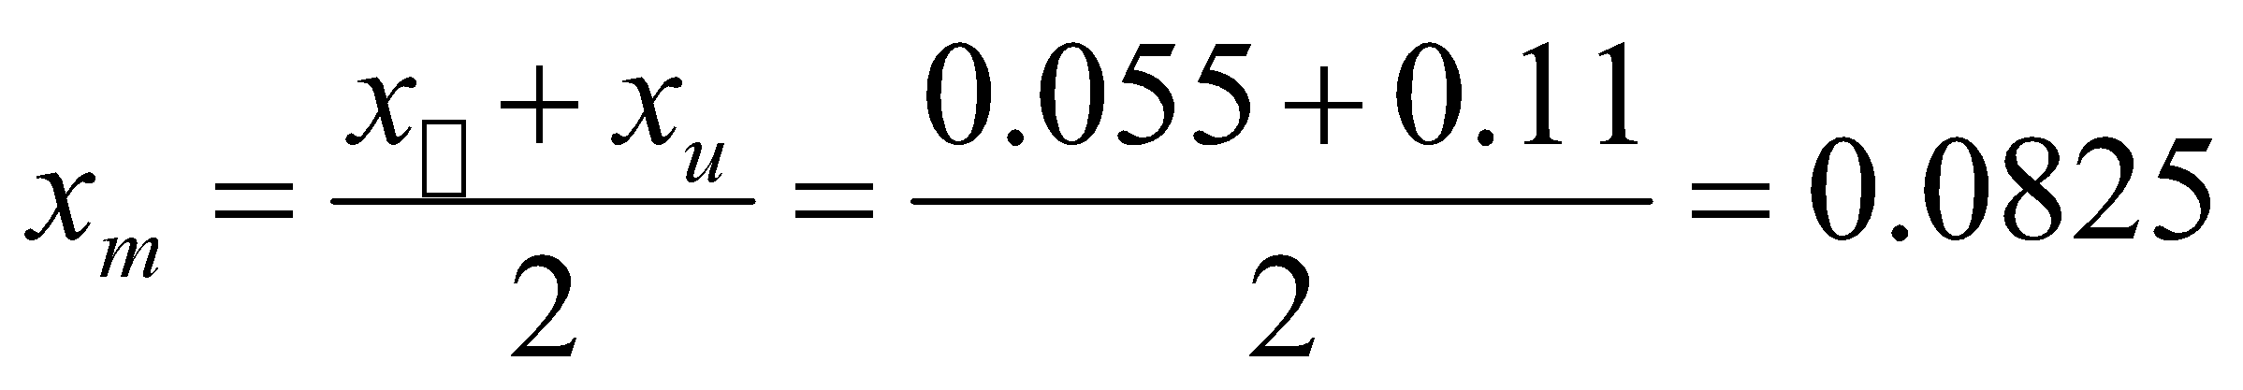
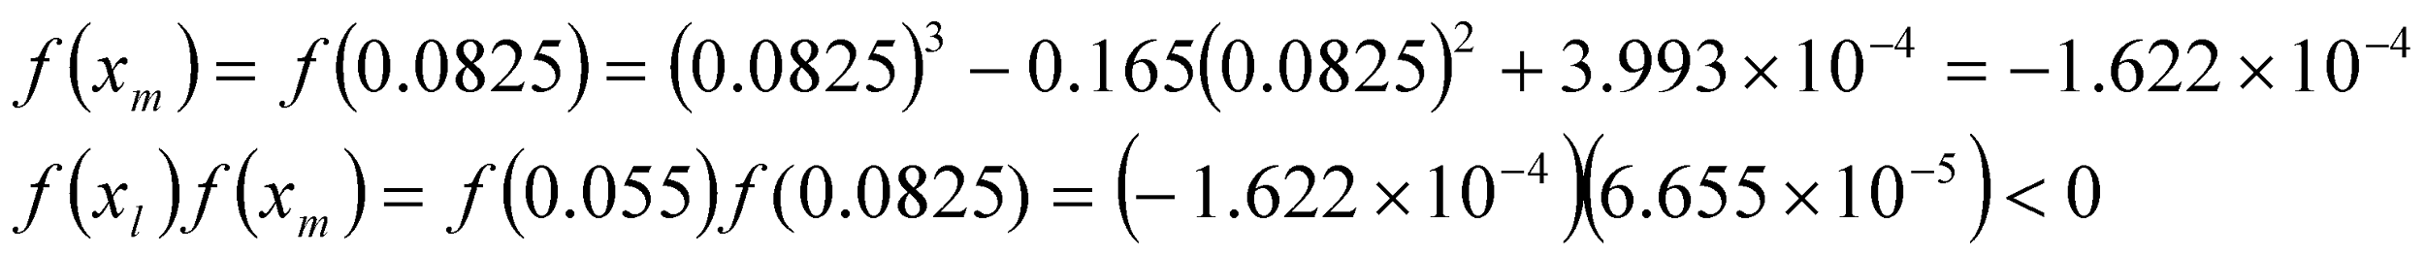
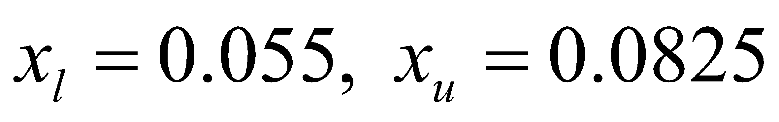
Example 1 Cont.
Iteration 2
The estimate of the root is
Hence the root is bracketed between x_{l} and x_{m}, that is, between 0.055 and 0.0825. So, the lower and upper limits of the new bracket are
‹#›

Slide 20
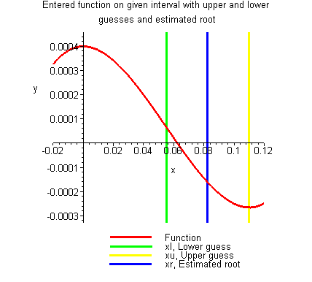
Example 1 Cont.
Figure 10 Estimate of the root for Iteration 2
‹#›

Slide 21
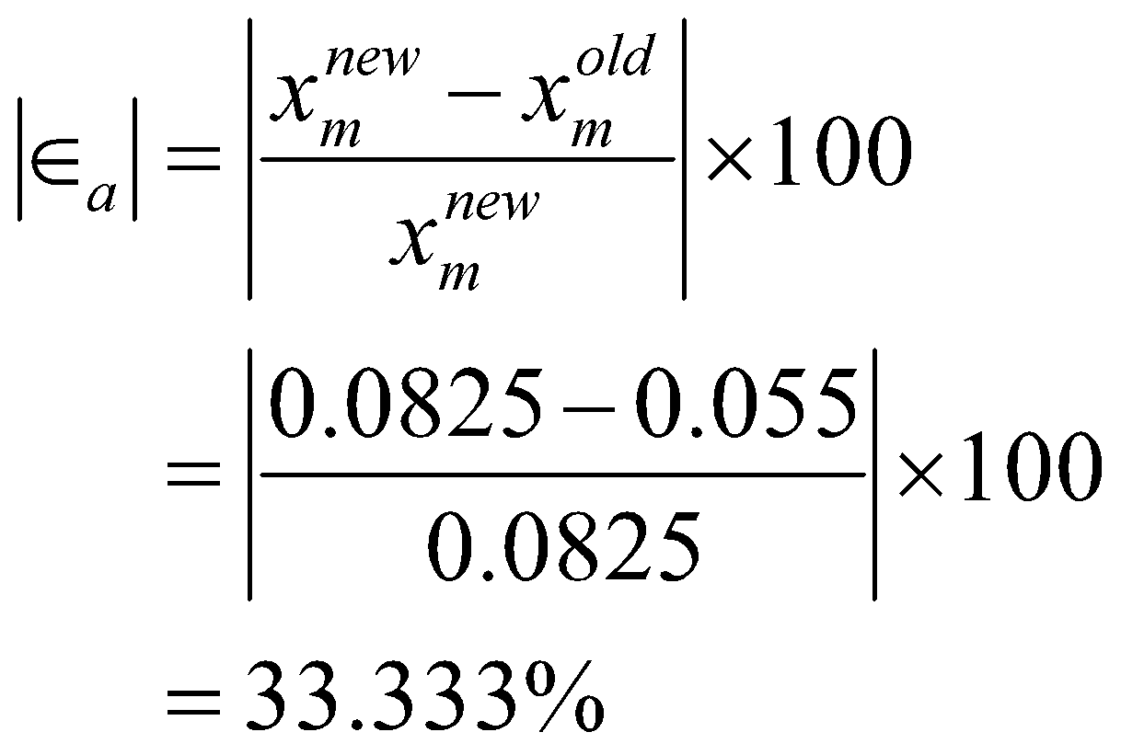
Example 1 Cont.
The absolute relative approximate error at the end of Iteration 2 is
None of the significant digits are at least correct in the estimate root of x_{m} = 0.0825 because the absolute relative approximate error is greater than 5%.
‹#›

Slide 22
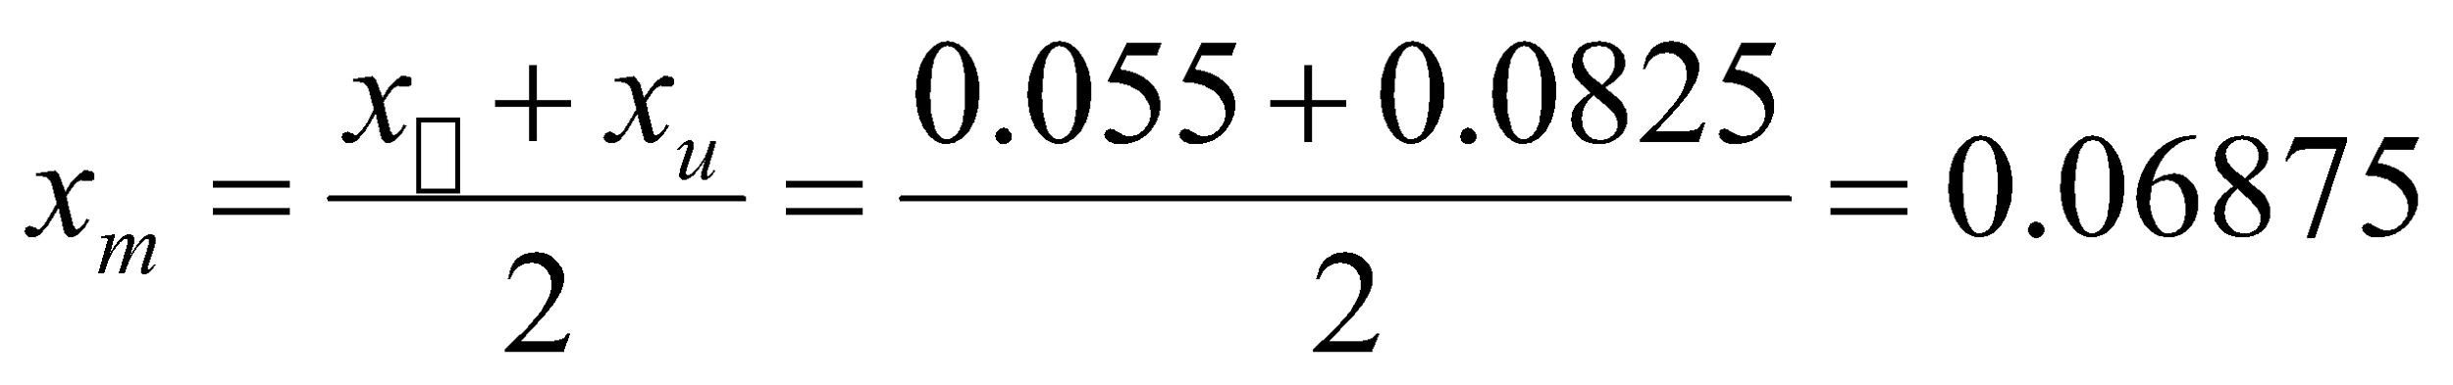
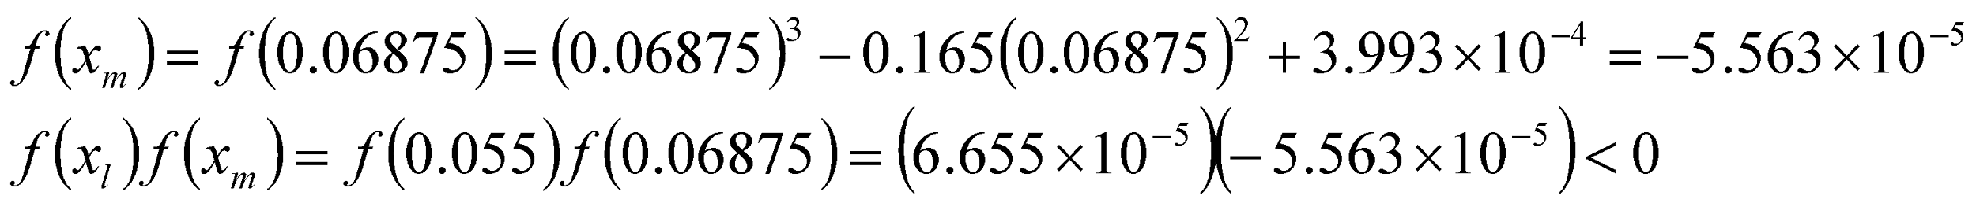
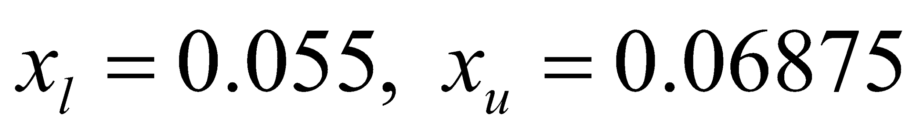
Example 1 Cont.
Iteration 3
The estimate of the root is
Hence the root is bracketed between x_{l} and x_{m}, that is, between 0.055 and 0.06875. So, the lower and upper limits of the new bracket are
‹#›

Slide 23
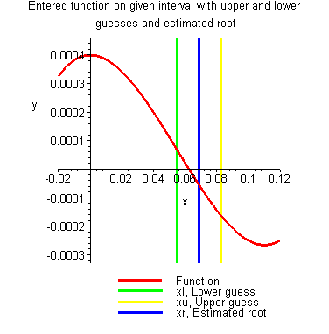
Example 1 Cont.
Figure 11 Estimate of the root for Iteration 3
‹#›

Slide 24
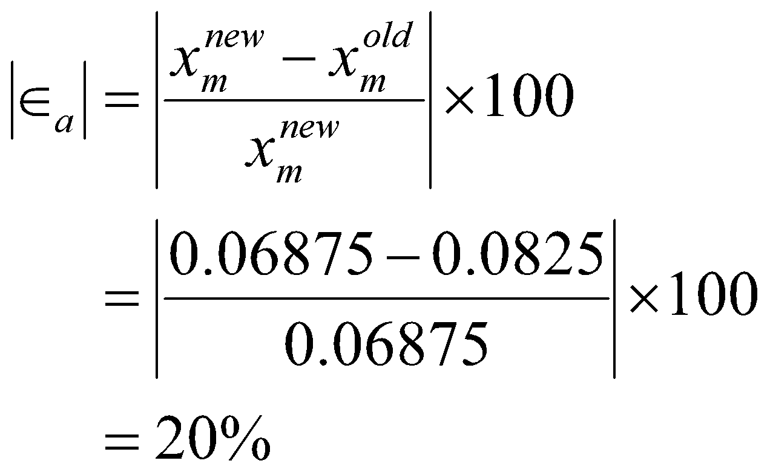
Example 1 Cont.
The absolute relative approximate error at the end of Iteration 3 is
Still none of the significant digits are at least correct in the estimated root of the equation as the absolute relative approximate error is greater than 5%.
Seven more iterations were conducted and these iterations are shown in Table 1.
‹#›

Slide 25
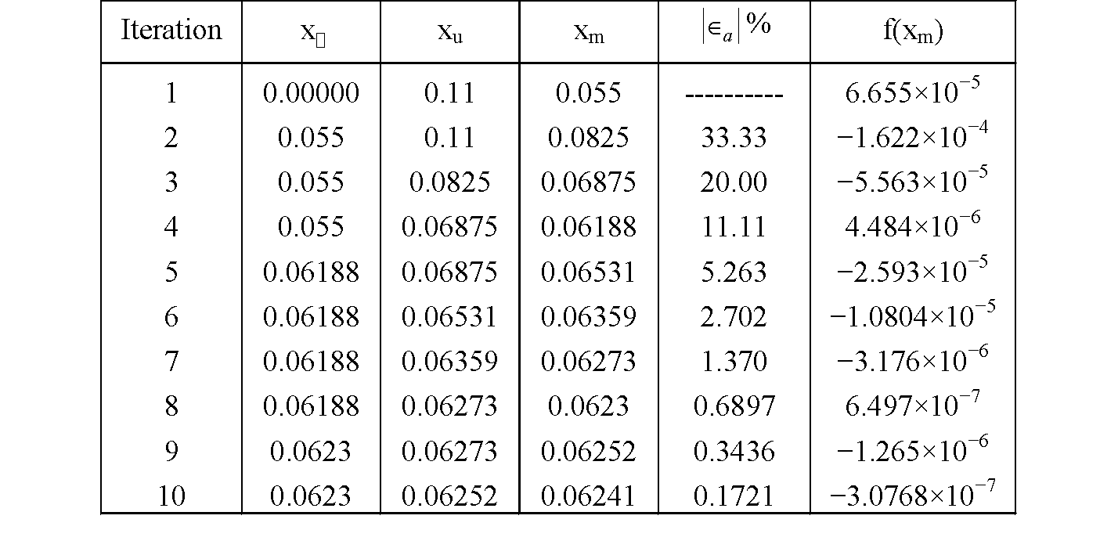
Table 1 Cont.
Table 1 Root of f(x)=0 as function of number of iterations for bisection method.
‹#›

Slide 26
Advantages
Always convergent (approaching closer to the real root)
The root bracket gets halved (divide into two parts of equal) with each iteration - guaranteed.
‹#›

Slide 27
Drawbacks
Slow convergence
If one of the initial guesses is close to the root, the convergence is slower
‹#›

Slide 28
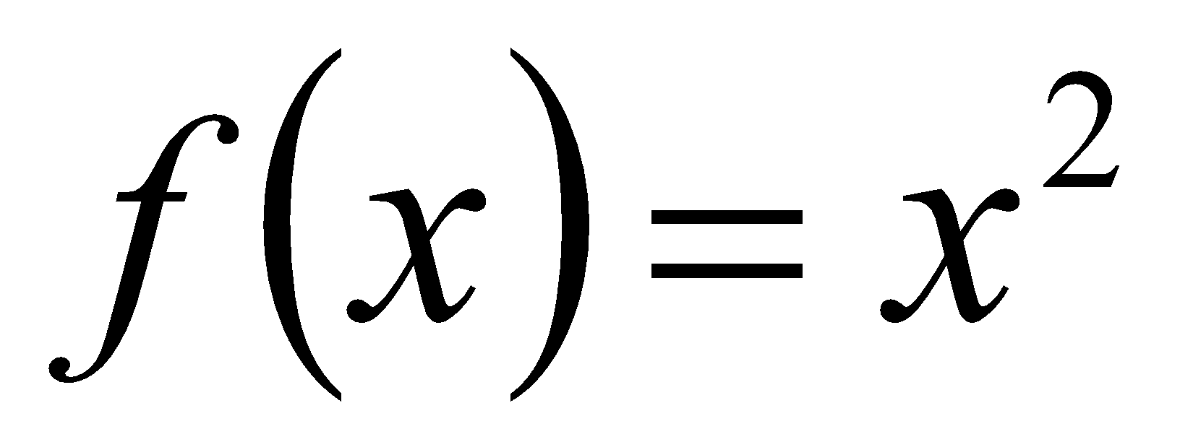
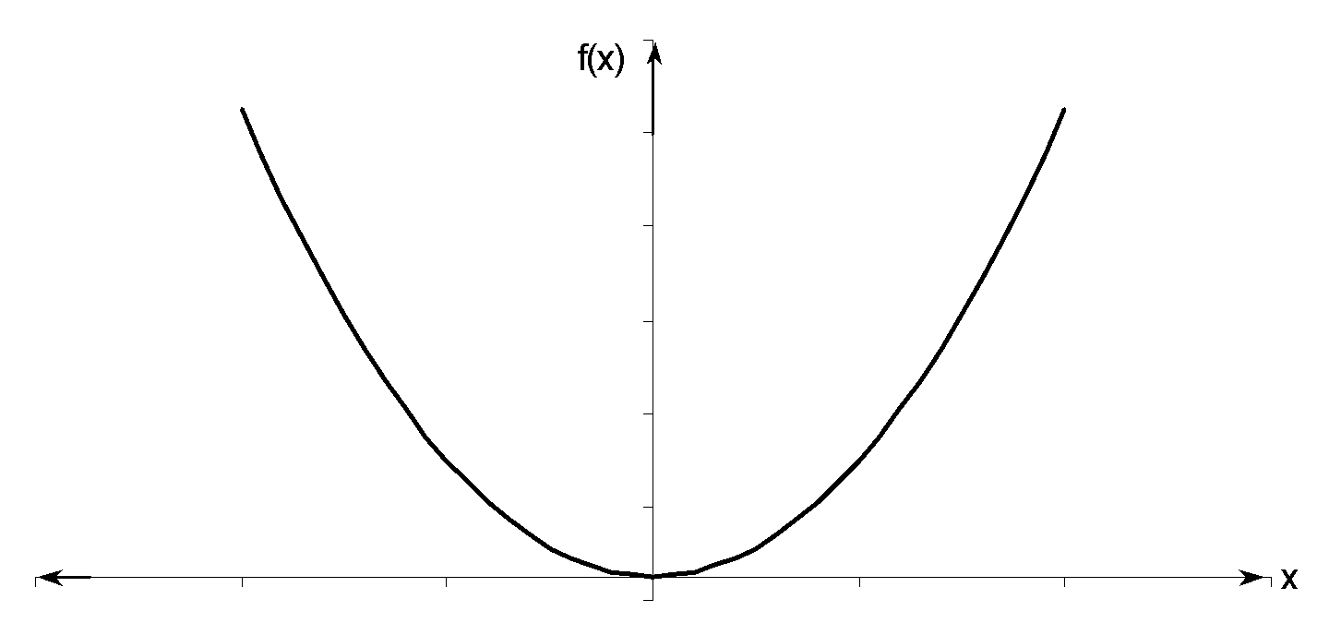
Drawbacks (continued)
If a function f(x) is such that it just touches the x-axis it will be unable to find the lower and upper guesses.
‹#›

Slide 29
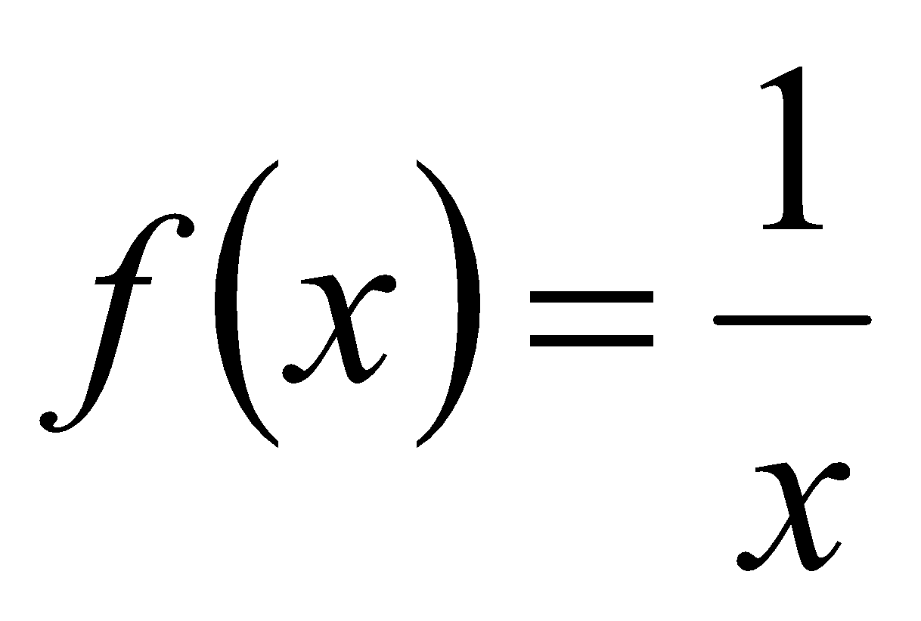
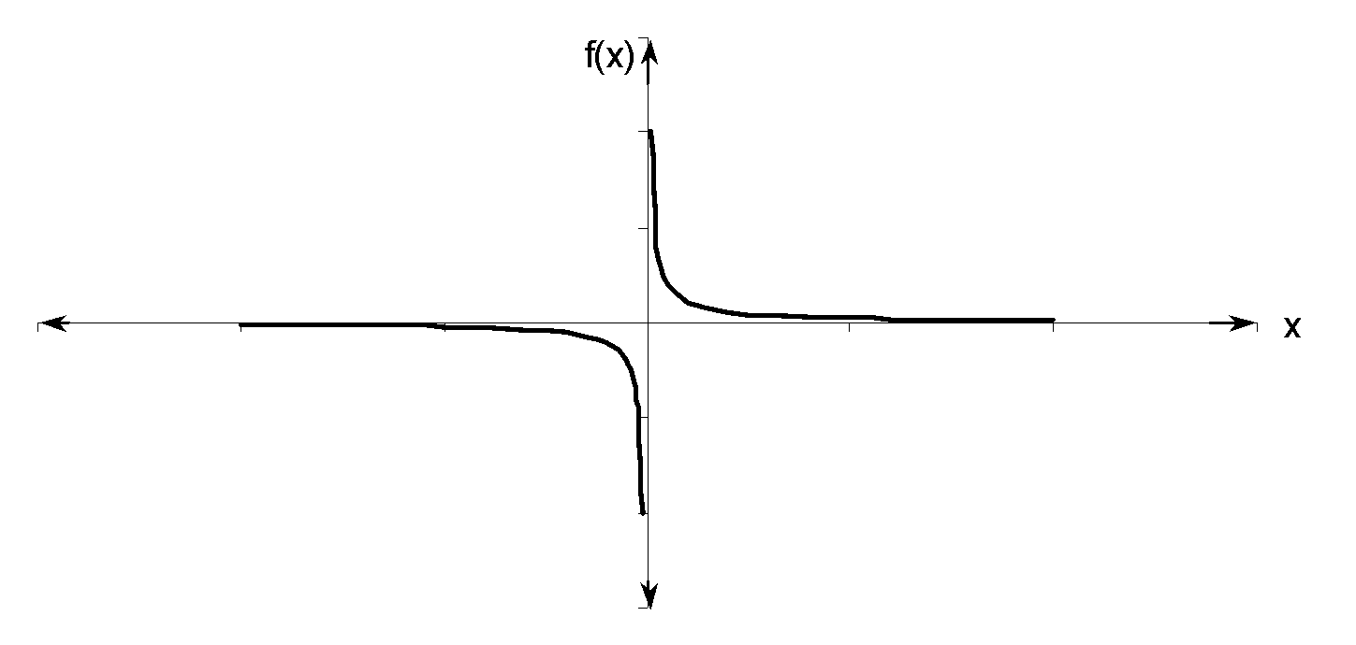
Drawbacks (continued)
Function changes sign but root does not exist
‹#›

Slide 30
THE END
Notes:
‹#›

